Slide 1

Sales Analysis
By Varsha Jain

Slide 2


Uncovering Insights from Real Sales Data
Using SQL

Slide 3




ABOUT THE PROJECT
Querying the database using SQL to answer various questions and analyze the data.
BASIC QUESTIONS
JOIN QUESTIONS
ADVANCE QUESTIONS

Slide 4

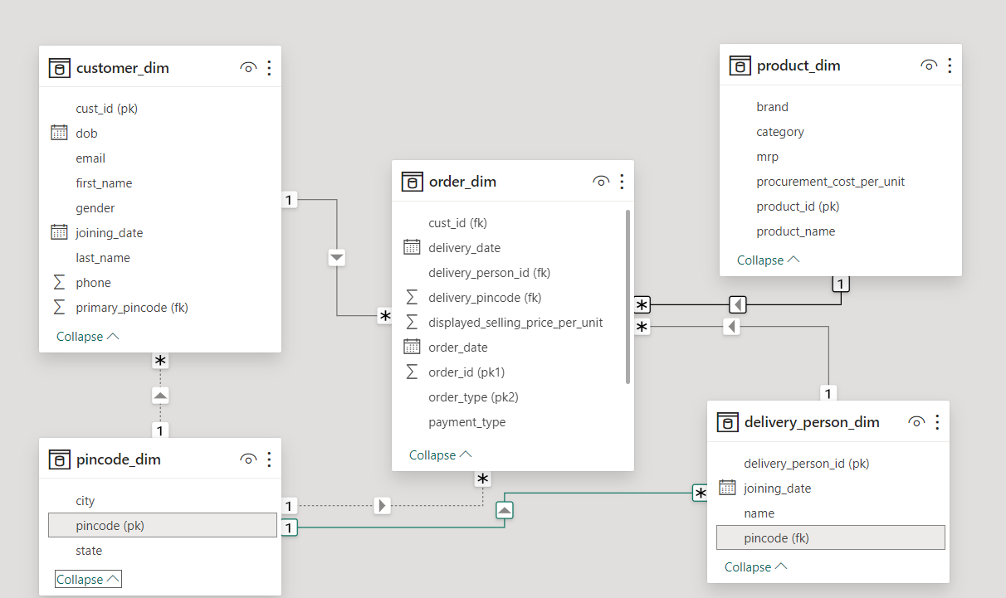
SCHEMA

Slide 5
BASIC QUESTIONS

Slide 6
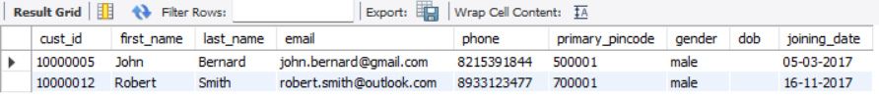
01) How many customers do not have DOB
information available?
SYNTAX
select * from customers
where dob = "" and dob is not null;

Slide 7
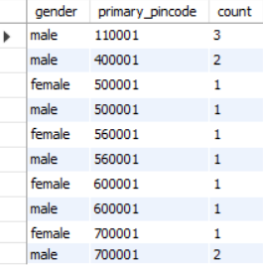
02) How many customers are there in each pin code and gender combination?
SYNTAX
select
gender,
primary_pincode,
count(*) as count
from
customers
group by
primary_pincode, gender
order by
primary_pincode;

Slide 8
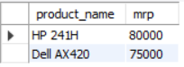
03) Print product name and mrp for products which have more than 50000 MRP
SYNTAX
select
product_name,
mrp
from
products
where
mrp>50000;

Slide 9
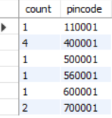
04) How many delivery person are there in each pincode?
SYNTAX
select
count(name) as count,
pincode
from
delivery_person
group by
pincode;

Slide 10
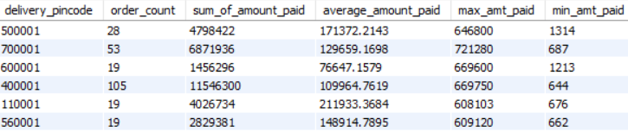
SYNTAX
select
delivery_pincode,
count(order_id) as order_count,
sum(total_amount_paid) as sum_of_amount_paid,
avg(total_amount_paid) as average_amount_paid,
max(total_amount_paid) as max_amt_paid,
min(total_amount_paid) as min_amt_paid
from
orders
where
payment_type = "cash" and order_type = "buy"
group by
delivery_pincode;
05) For each Pin code, print the count of orders, sum of total amount paid, average amount paid, maximum amount paid, minimum amount paid for the transactions which were paid by 'cash'. Take only 'buy' order types

Slide 11
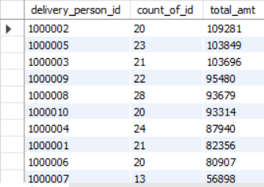
06) For each delivery_person_id, print the count of orders and total amount paid for product_id = 12350 or 12348 and total units > 8. Sort the output by total amount paid in descending order. Take only 'buy' order types
SYNTAX
select
delivery_person_id, count(order_id) as count_of_id ,
sum(total_amount_paid) as total_amt
from
orders
where
product_id = "12350" or product_id = "12348"
and tot_units>8
and order_type = "buy"
group by
delivery_person_id
order by
sum(total_amount_paid) desc;

Slide 12
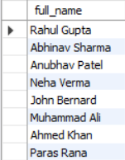
07) Print the Full names (first name plus last name) for customers that have email on "gmail.com"?
SYNTAX
select
concat_ws(' ',first_name, last_name) as full_name
from
customers
where
email like "%gmail.com%";

Slide 13
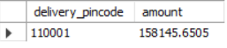
08) Which pin code has average amount paid more than 150,000? Take only 'buy' order types
SYNTAX
select
delivery_pincode,
avg(total_amount_paid) as amount
from
orders
where
order_type="buy"
group by
delivery_pincode having avg(total_amount_paid) >150000;

Slide 14
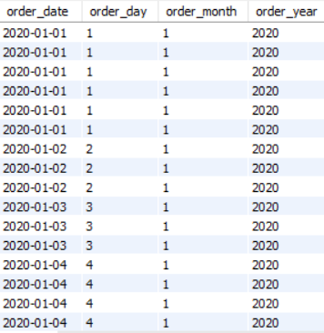
09) Create following columns from order_dim data -
a) order_date b) Order day
c) Order month d)Order year
SYNTAX
select
order_date,
day(order_date) as order_day,
month(order_date) as order_month,
year(order_date) as order_year
from orders;

Slide 15
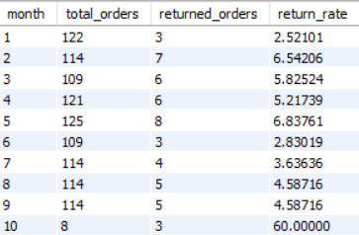
10) How many total orders were there in each month and how many of them were returned? Add a column for return rate too.
SYNTAX
select * from orders
where order_type="buy";
select
month(order_date) as month,
count(*) as total_orders,
sum(case when order_type = 'return' then 1 else 0 end) as returned_orders,
(100.0 * sum(case when order_type = 'return' then 1 else 0 end)) / sum(case when order_type="buy" then 1 else 0 end) as return_rate
from
orders
group by
month(order_date);

Slide 16
JOIN QUESTIONS

Slide 17
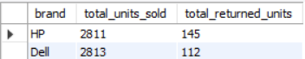
11) How many units have been sold by each brand? Also get total returned units for each brand.
SYNTAX
alter table
products
rename column
MyUnknownColumn to product_id;
select
products.brand,
sum(orders.tot_units) as total_units_sold,
sum(case when orders.order_type = "return" then orders.tot_units else 0 end) as total_returned_units
from
products
left join
orders on products.product_id = orders.product_id
group by
products.brand;

Slide 18
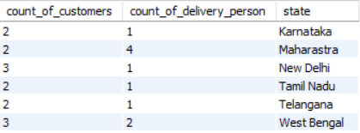
12) How many distinct customers and delivery boys are there in each state?
SYNTAX
select
count(distinct customers.cust_id) as count_of_customers,
count(distinct delivery_person.delivery_person_id) as count_of_delivery_person,
pincode.state
from
customers
left join
delivery_person on customers.primary_pincode = delivery_person.pincode
left join
pincode on customers.primary_pincode = pincode.pincode
group by
pincode.state;

Slide 19
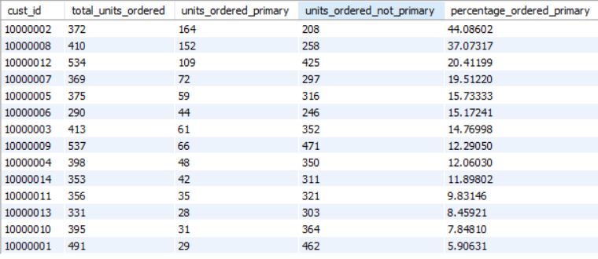
13) For every customer, print how many total units were ordered, how many units were ordered from their primary_pincode and how many were ordered not from the primary_pincode. Also calulate the percentage of total units which were ordered from primary_pincode. Sort by the percentage column in descending order.
SYNTAX
select
customers.cust_id,
sum(orders.tot_units) as total_units_ordered,
sum(case when orders.delivery_pincode = customers.primary_pincode then orders.tot_units else 0 end) as units_ordered_primary,
sum(case when orders.delivery_pincode <> customers.primary_pincode then orders.tot_units else 0 end) as units_ordered_not_primary,
(100.0 * sum(case when orders.delivery_pincode = customers.primary_pincode then orders.tot_units else 0 end)) / sum(orders.tot_units) as percentage_ordered_primary
from
orders
left join
customers on orders.cust_id = customers.cust_id
group by
customers.cust_id
order by
percentage_ordered_primary desc;

Slide 20
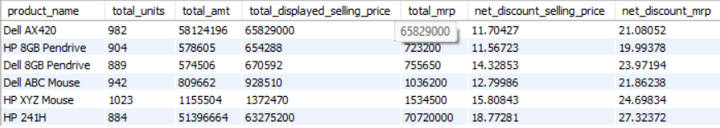
14) For each product name, print the sum of number of units, total amount paid, total displayed selling price, total mrp of these units, and finally the net discount from selling price.
SYNTAX
select
product_name,
sum(orders.tot_units) as total_units,
sum(orders.total_amount_paid) as total_amt,
sum(orders.displayed_selling_price_per_unit*orders.tot_units) as total_displayed_selling_price,
sum(products.mrp*orders.tot_units) as total_mrp,
(100.0 - 100.0 * sum(orders.total_amount_paid) / sum(orders.displayed_selling_price_per_unit*orders.tot_units)) as net_discount_selling_price,
(100.0 - 100.0 * sum(orders.total_amount_paid) / sum(products.mrp*orders.tot_units)) as net_discount_mrp
from
orders
left join
products on orders.product_id = products.product_id
group by
products.product_name;

Slide 21
ADVANCE QUESTIONS

Slide 22
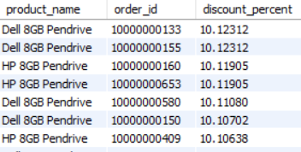
15) For every order_id (exclude returns), get the product name and calculate the discount
percentage from selling price. Sort by highest discount and print only those rows where discount percentage was above 10.10%.
SYNTAX
select
products.product_name,
orders.order_id,
(100.0 - (100.0 * sum(orders.total_amount_paid) / sum(orders.displayed_selling_price_per_unit*orders.tot_units))) as discount_percent
from
orders
left join
products on orders.product_id = products.product_id
where
orders.order_type = "buy"
group by
products.product_name, orders.order_id
having
discount_percent > 10.10
order by
discount_percent desc;

Slide 23
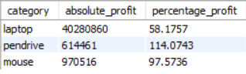
16) Using the per unit procurement cost in product_dim, find which product category has
made the most profit in both absolute amount and percentage
SYNTAX
select
products.category,
sum(orders.total_amount_paid - products.procurement_cost_per_unit*orders.tot_units) as absolute_profit,
100* (sum(orders.total_amount_paid)/ sum(products.procurement_cost_per_unit*orders.tot_units))-100 as percentage_profit
from
orders
left join
products on orders.product_id = products.product_id
group by
products.category;

Slide 24
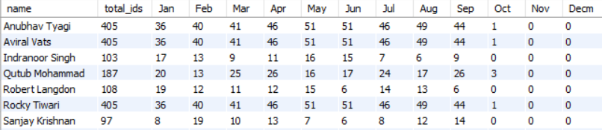
17) For every delivery person(use their name), print the total number of order ids (exclude returns) by month in separate columns
SYNTAX
select
delivery_person.name ,
count(distinct orders.order_id) as total_ids,
sum(case when month(order_date) =1 then 1 else 0 end) as Jan,
sum(case when month(order_date) =2 then 1 else 0 end) as Feb,
sum(case when month(order_date) =3 then 1 else 0 end) as Mar,
sum(case when month(order_date) =4 then 1 else 0 end) as Apr,
sum(case when month(order_date) =5 then 1 else 0 end) as May,
sum(case when month(order_date) =6 then 1 else 0 end) as Jun,
sum(case when month(order_date) =7 then 1 else 0 end) as Jul,
sum(case when month(order_date) =8 then 1 else 0 end) as Aug,
sum(case when month(order_date) =9 then 1 else 0 end) as Sep,
sum(case when month(order_date) =10 then 1 else 0 end) as Oct,
sum(case when month(order_date) =11 then 1 else 0 end) as Nov,
sum(case when month(order_date) =12 then 1 else 0 end) as Decm
from
orders
left join
delivery_person on orders.delivery_pincode = delivery_person.pincode
where
orders.order_type="buy"
group by
delivery_person.name;

Slide 25
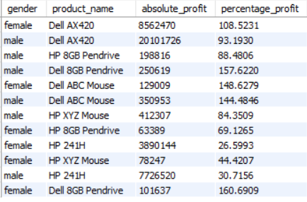
18) For each gender - male and female - find the absolute and percentage profit by product name
SYNTAX
select
customers.gender,
products.product_name,
sum(orders.total_amount_paid - products.procurement_cost_per_unit*orders.tot_units) as absolute_profit,
100* (sum(orders.total_amount_paid)/ sum(products.procurement_cost_per_unit*orders.tot_units))-100 as percentage_profit
from
orders
left join
customers on orders.cust_id = customers.cust_id
left join
products on orders.product_id = products.product_id
group by
customers.gender,
products.product_name;

Slide 26
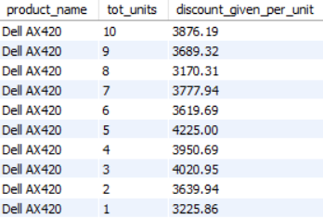
19) Generally the more numbers of units you buy, the more discount seller will give you. For 'Dell AX420' is there a relationship between number of units ordered and average discount from selling price? Take only 'buy' order types
SYNTAX
select
products.product_name,
orders.tot_units,
round((avg((orders.displayed_selling_price_per_unit*orders.tot_units)-orders.total_amount_paid)/orders.tot_units),2) as discount_given_per_unit
from
orders
left join
products on orders.product_id = products.product_id
where
orders.order_type = "buy" and products.product_name = "Dell AX420"
group by
orders.tot_units
order by
orders.tot_units desc;

Slide 27
CONCLUSIONS

Slide 28




01
02
03
There are more male customers in each pin code
Pin code 400001 has maximum no. of delivery person
October month has the highest return rate

Slide 29
04
05
06
West Bengal and New Delhi have maximum distinct customers whereas Maharashtra has highest distinct count of delivery person
Customer having customer ID 10000002 has majorly ordered from primary pin code
Laptops have the highest absolute profit on the other hand Pen drive has the highest percentage profit.

Slide 30

THANK YOU

